Slide 1
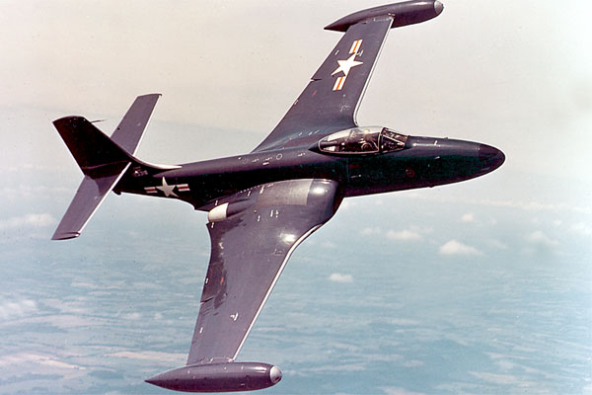
Aerodynamics 3

Slide 2
Back to basics
IAS (Indicated Air Speed)
Airspeed indicated on the ASI
CAS (Calibrated Air Speed)
IAS corrected for Instrument error and Position error
EAS (Equivalent Air Speed)
CAS corrected for compressibility error
TAS (True Air Speed)
EAS corrected for density

Slide 3
Asymmetric flight
Describe the balance of forces in normal and asymmetric flight.
Define the term “Critical engine”.
Define V_{MCA}, V_{MCG} and some contributing factors.

Slide 4
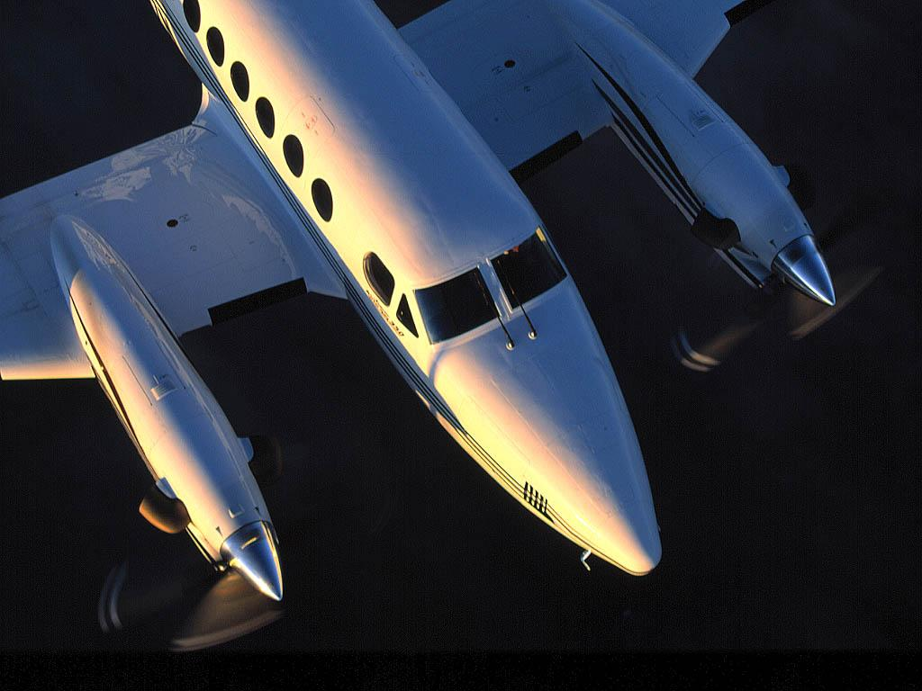
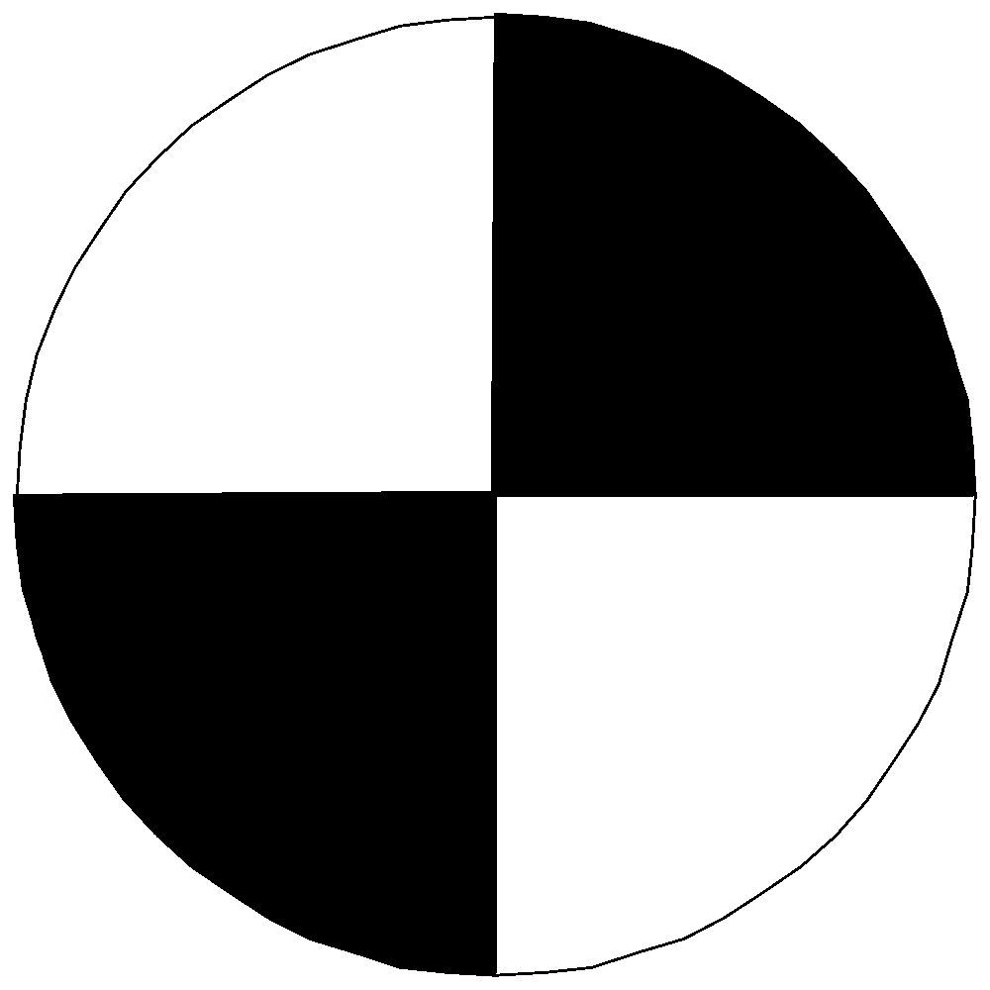

Normal cruise flight
T1
TR
T2

Slide 5
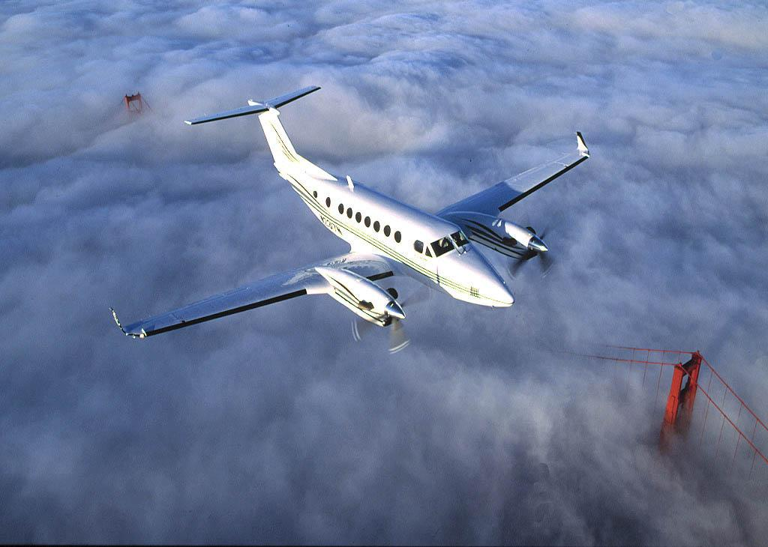
Drag
Lift
Thrust
Weight

Slide 6
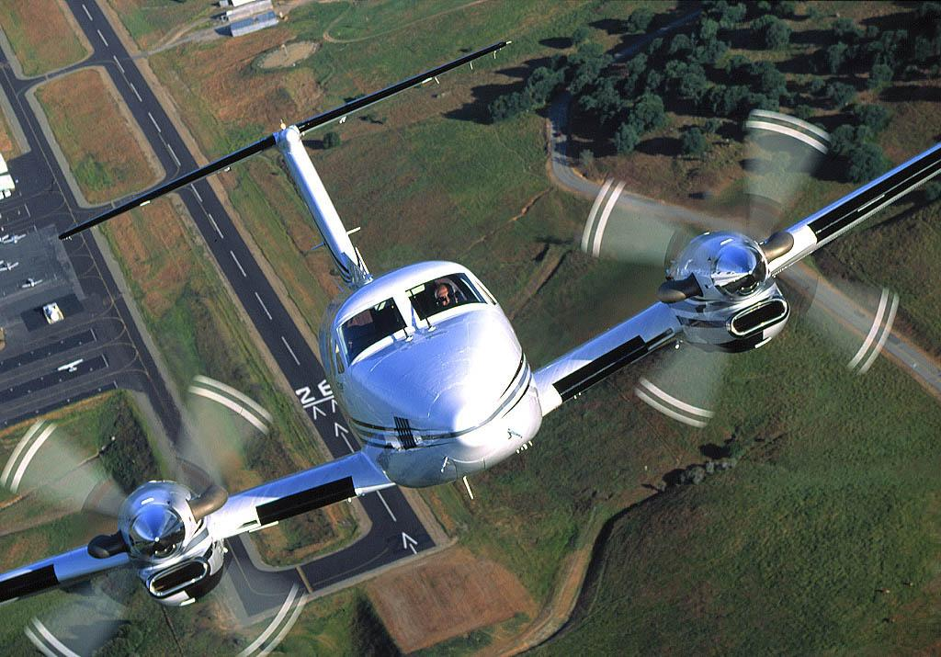

Slide 7
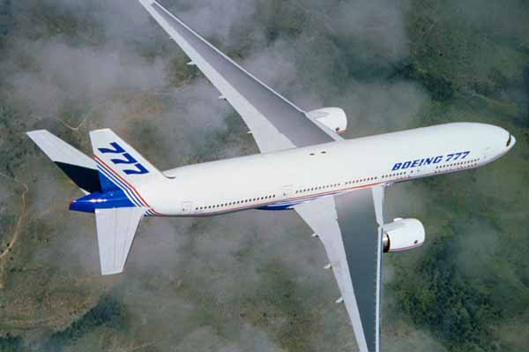
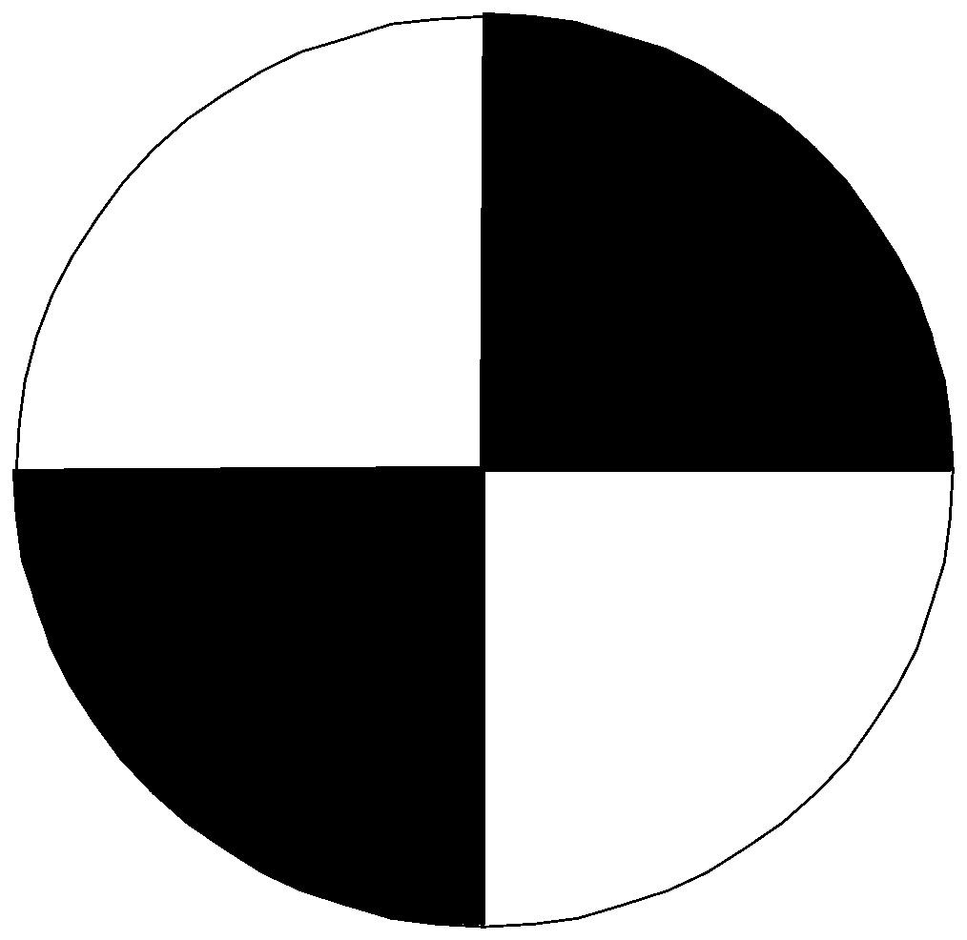
Asymmetric Flight
THRUST
YAWING MOMENT WITH
RIGHT FAILED ENGINE
DRAG

Slide 8
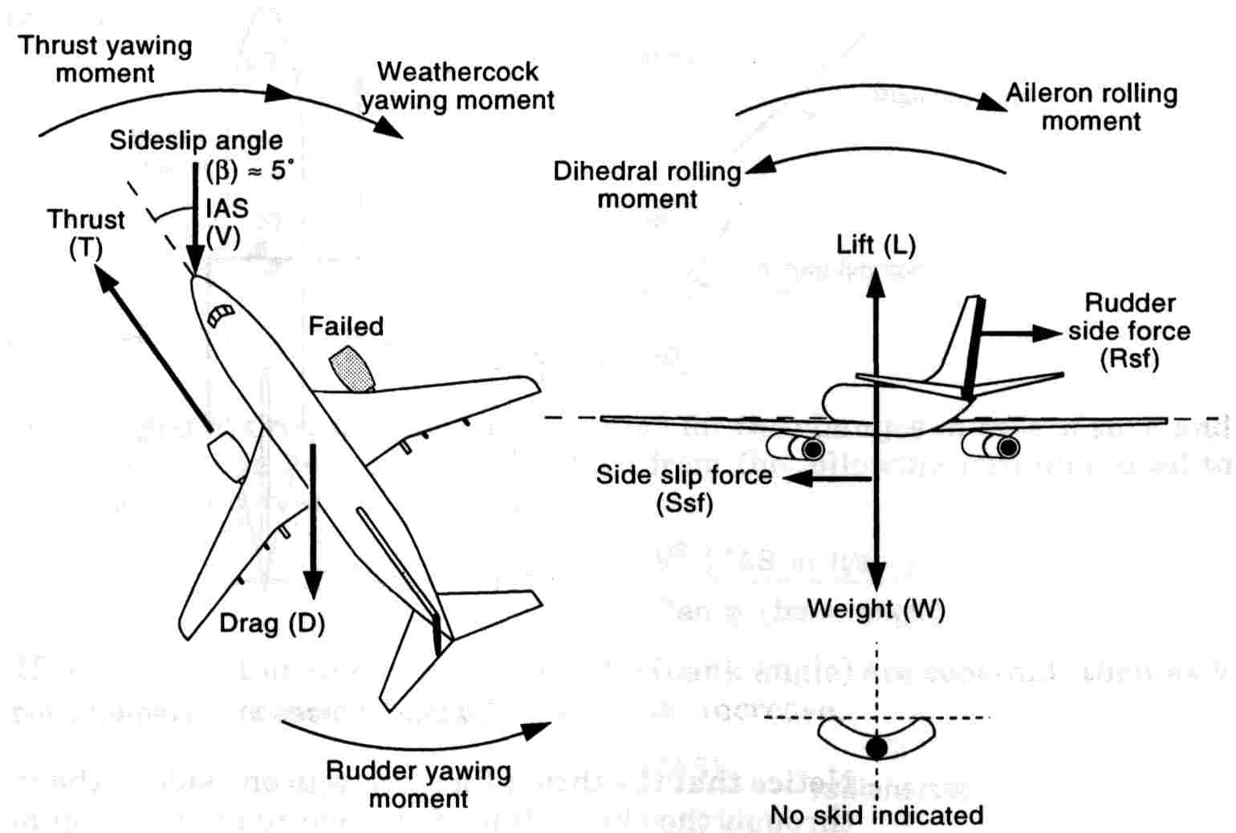
Asymmetric Flight (cont)

Slide 9
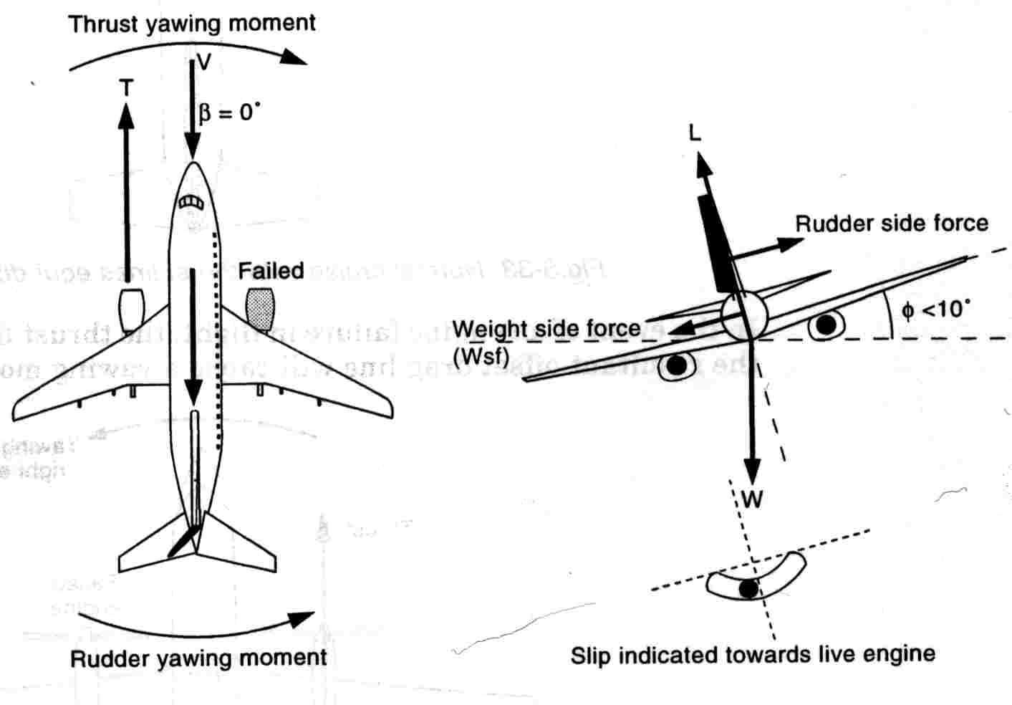
Asymmetric Flight (cont)

Slide 10
Propeller driven aircraft
Propeller torque reaction
Loss of induced lift
Asymmetric blade effect

Slide 11
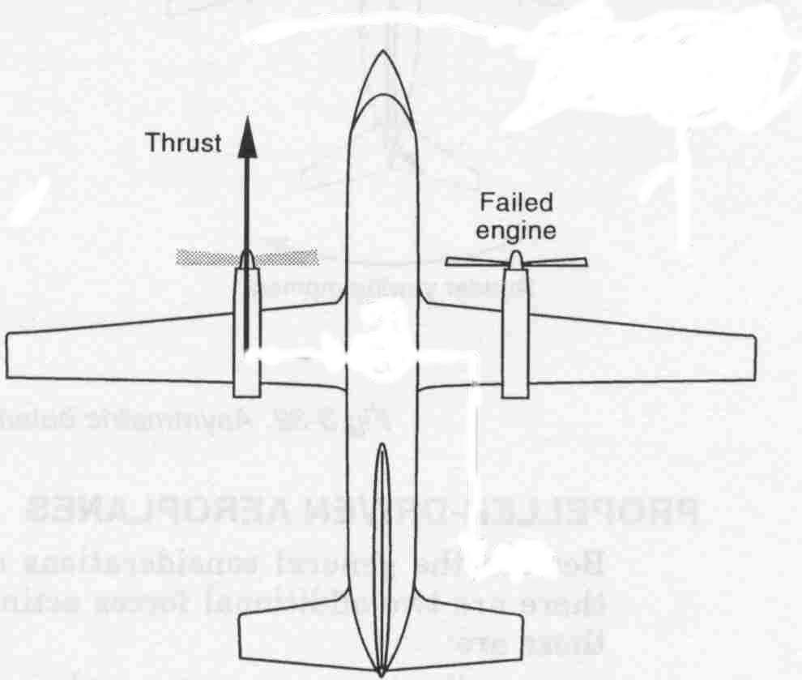
Loss of induced lift
ROLLING MOMENT
AREA OF
INDUCED LIFT

Slide 12
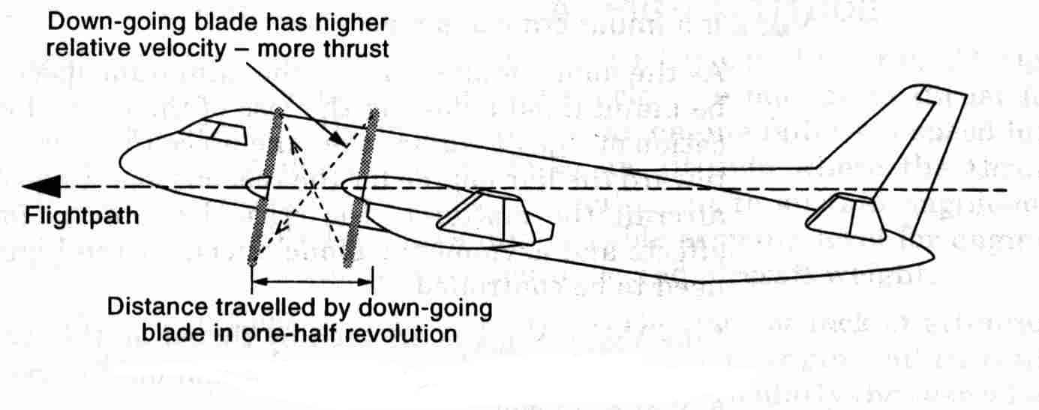
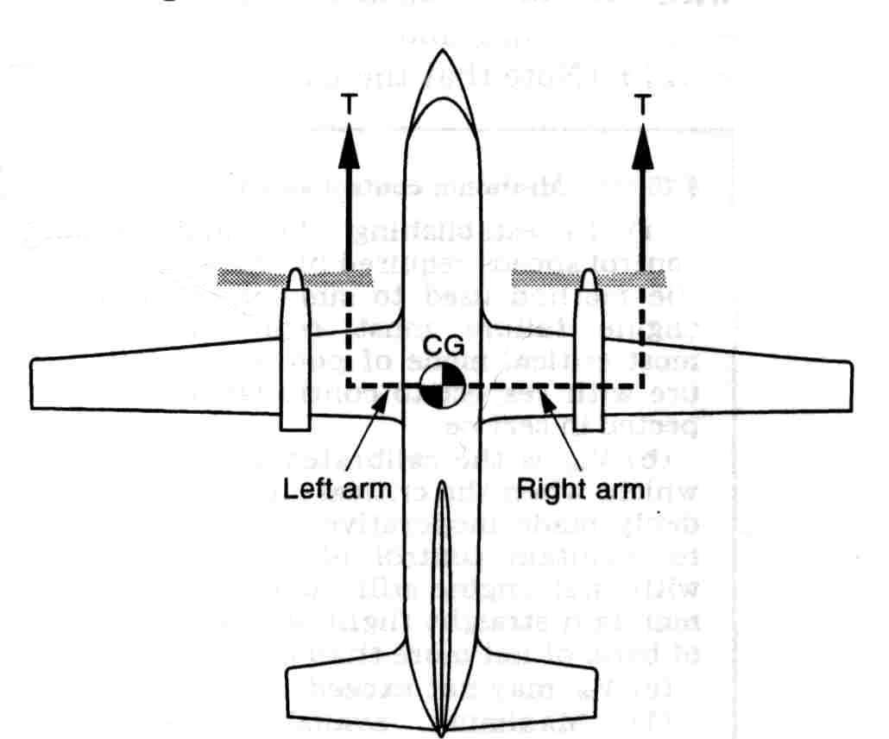
Asymmetric blade effect
MAX YAW MOMENT
WITH CRITICAL
ENGINE FAILED
CRITICAL
ENGINE

Slide 13
Minimum control speeds
V_{MCG}
Minimum Control Speed on the Ground
V_{MCA}
Minimum Control Speed in the Air
V_{MCL}
Minimum Control Speed in the Landing config

Slide 14
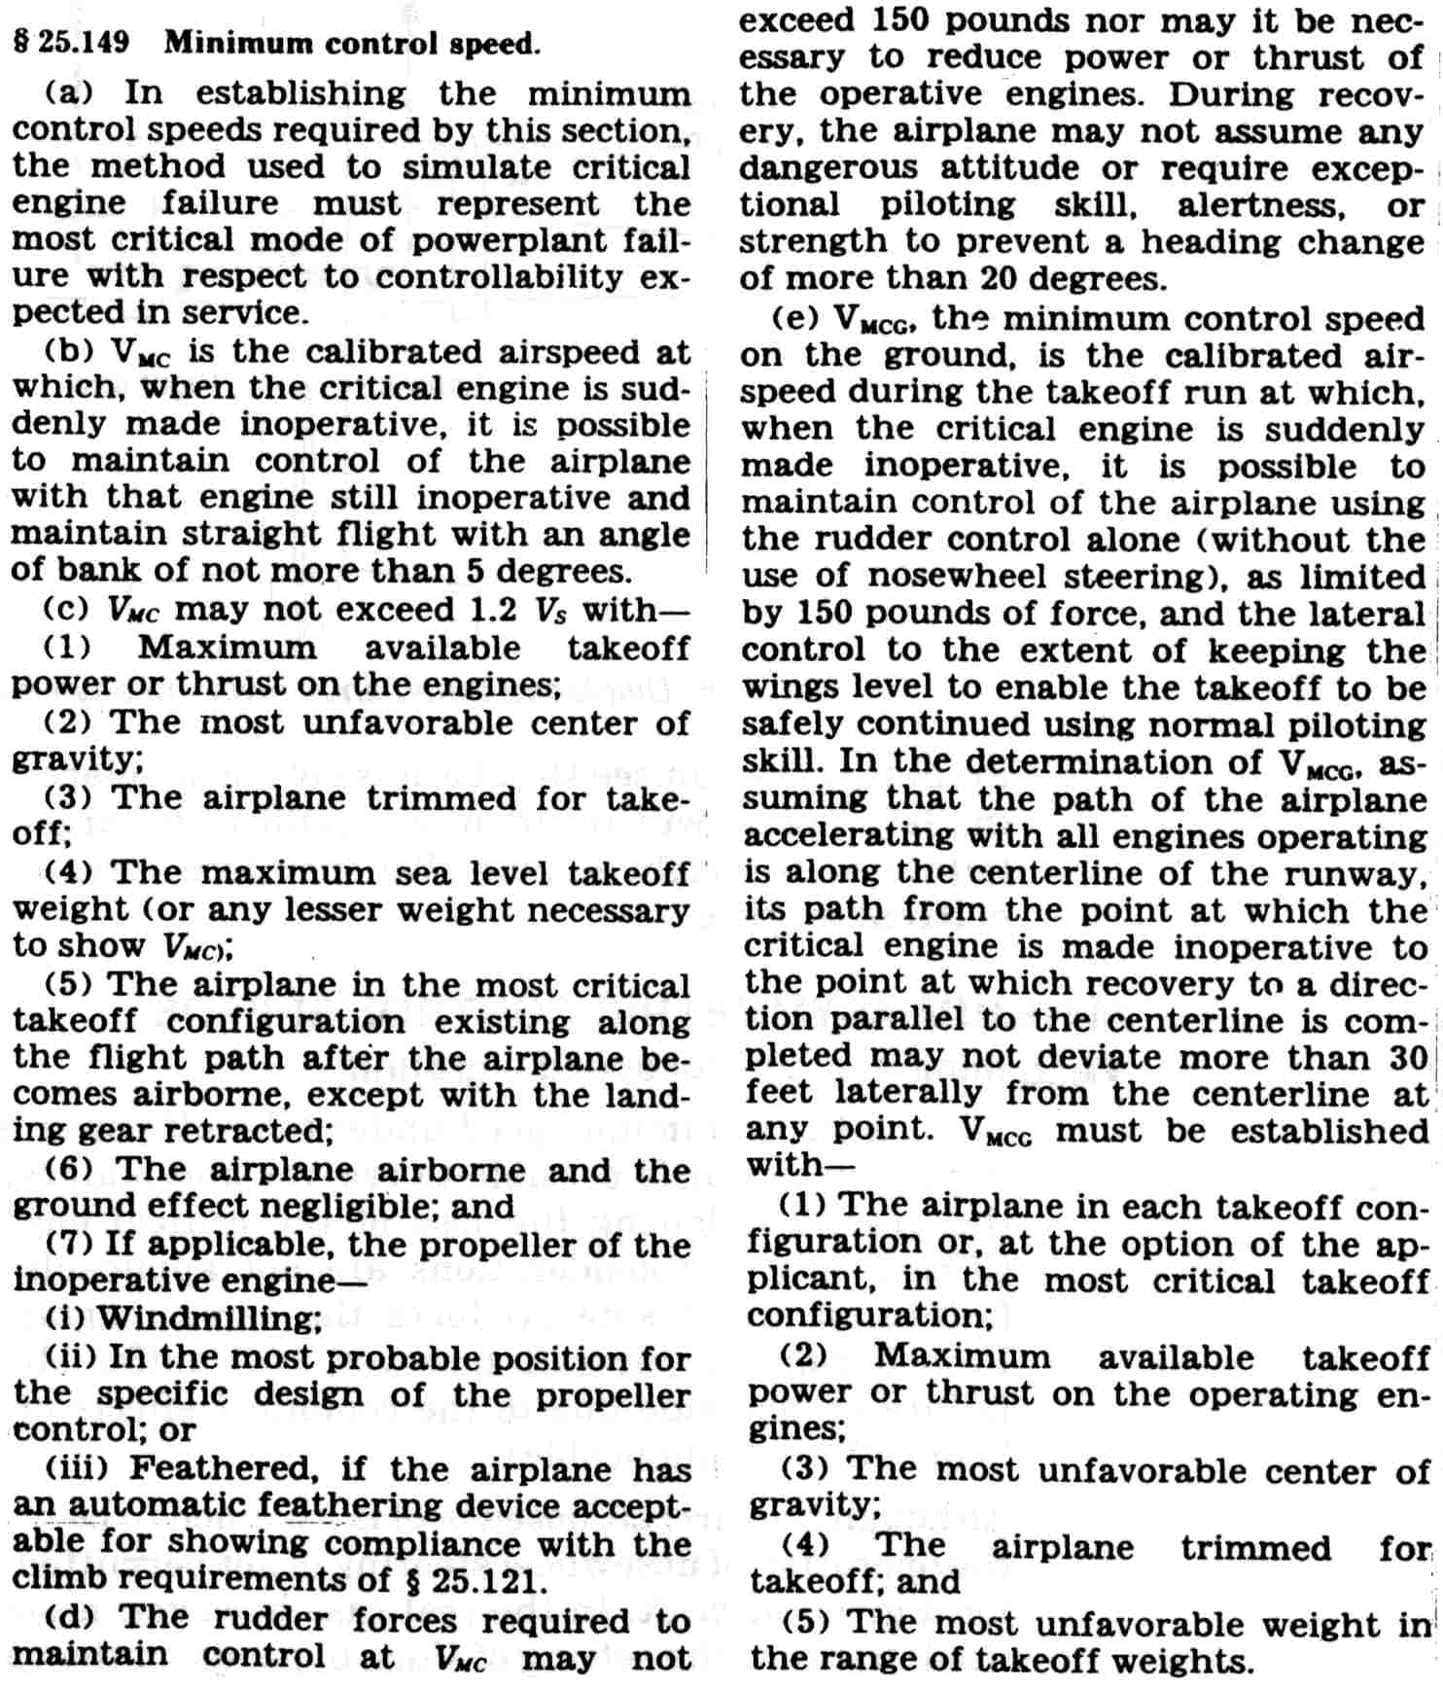
Extract from FAR 25

Slide 15
Windshear
The Problem:
VAT = 130 KIAS
HEADWIND = 30 KNOTS
G/S = TAS - HEADWIND = 100 KNOTS
VAT = 1.3VS
The Solution:
VAPP = VAT + (ALL HEADWIND + 1/2 GUST) TO A MAXIMUM OF 20 KNOTS

Slide 16
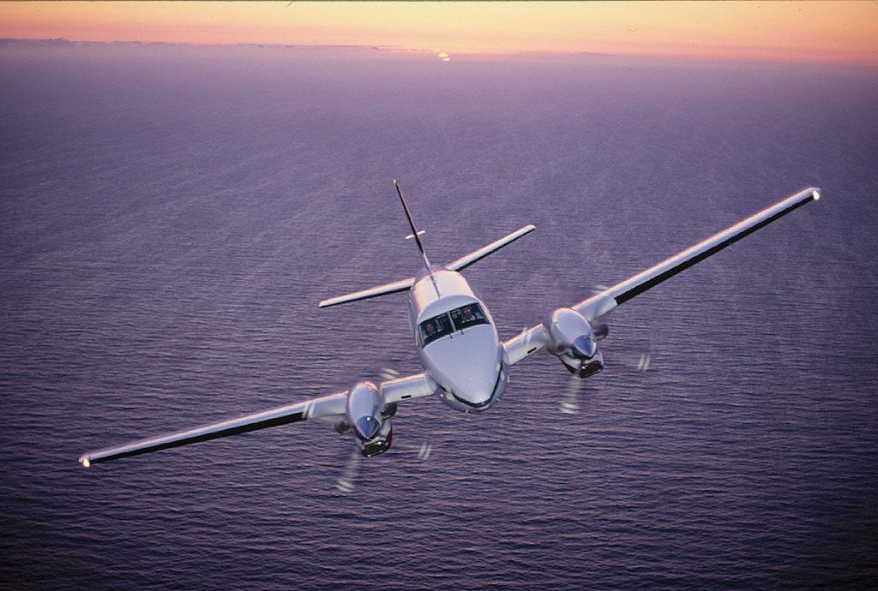
BREAK TIME

